Slide 1





From Disconnection to Belonging: Simple Tools for Time-Strapped Educators
Purpose + Belonging
Belle Liang, Ph.D. & Tim Klein, LCSW
Boston College, Center for Reflective Intelligence

Slide 2


THE ISSUE:
We are in the midst of a disconnection crisis.
4

Slide 3



Students feel disconnected from themselves.
42%
63%
22%
so depressed it was difficult to function.
reported overwhelming anxiety.
feel they don't matter to people.
(ACHA-NCHA, 2023)
5

Slide 4
They feel disconnected from school and work.
52%
29%
48%
overwhelmed by academic workload.
felt education not worth the cost.
felt academics/work not prepping them for future.
(ACHA-NCHA, 2023)
(Gallup & Lumina, 2022)
(NSLS, 2022)

Slide 5
They feel disconnected from their futures.
51%
38%
<50%
of college grads regret a major decision (e.g., college, major).
"don't know what to do with their lives."
find meaningful work.
(Gallup & Bates, 2022)
(Strada Ed Network, 2023)
(Strada & Gallup, 2017)

Slide 6



When it comes to your students,
where do you see disconnection showing up the most?
(Choose up to two)
A. Social isolation
B. Struggling with identity or self-worth
C. Disengagement from school
D. Anxiety about the future
E. Something else?

Slide 7
Why is this happening?

Slide 8
We’ve never taught people how to
play
game.
the

Slide 9



How Do I Become Successful?
11

Slide 10



The Performance Mindset
12

Slide 11
Where do you most see the Performance Mindset showing up in your students?
(Select all that apply)
A. Fear of making mistakes
B. Obsession with grades/outcomes
C. Overcommitment to activities
D. Seeking validation or approval
E. Something else?

Slide 12



How Do I Become Happy?
14

Slide 13

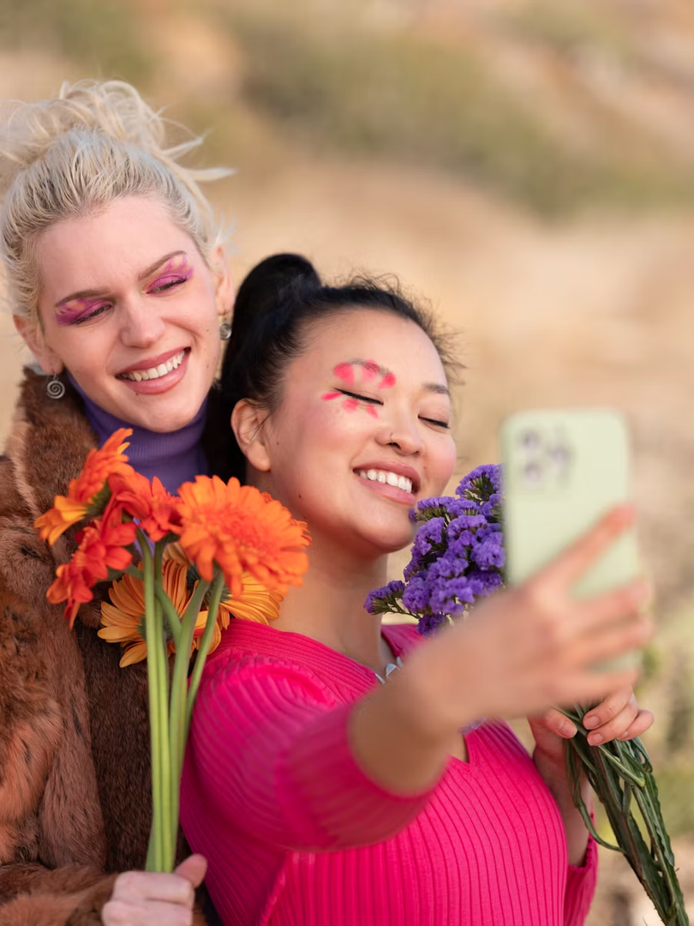


The
Passion Mindset
15

Slide 14
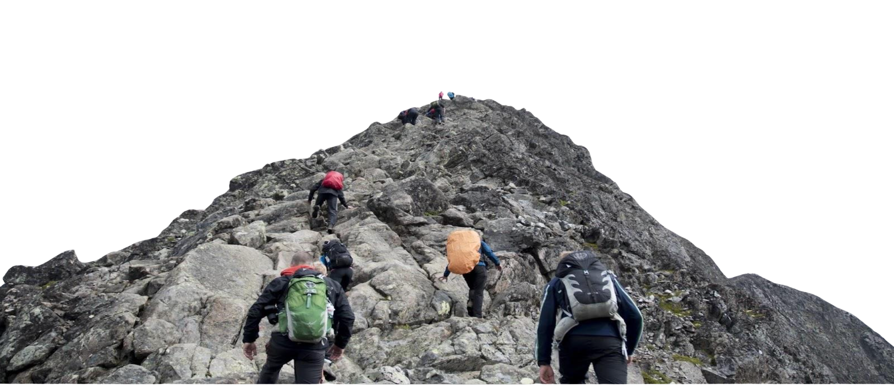
What am I supposed to do?
Are others more successful than me?
Are others more happy than me?
Am I successful enough?
Am I happy enough?
How do I succeed?
How do I become happy?

Slide 15


The
Purpose Mindset

Slide 16




Purpose is living a life that's personally meaningful with an intention to contribute in the world.
18

Slide 17
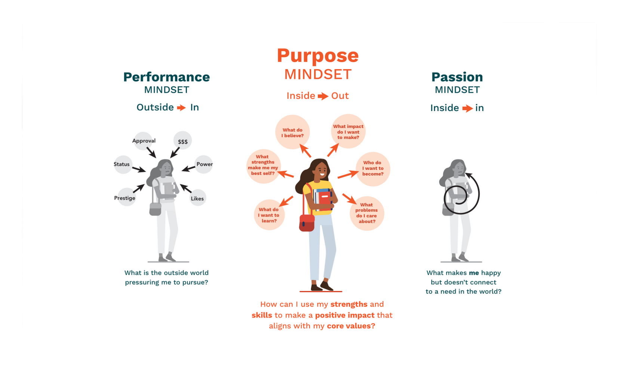


THE ANTIDOTE:
The
Purpose Mindset
People with purpose feel deeply connected to who they are, what they want, and what they are doing.
19

Slide 18

Purposeful people are more successful & happy.
MENTAL + PHYSICAL HEALTH
  lower levels of depression and anxiety
  increased wellbeing & reduced impact of psychological stress/ PTSD
  better support networks in college
  improved physical health & longevity
ACADEMIC & CAREER SUCCESS
  academically engaged
  better GPAs
  higher retention rates
  academic standing
  graduates w/ purposeful work 10x more likely to have high overall wellbeing.
(Yukhymenko-Lescroart, M. A., & Sharma, G, 2020; Gallup & Bates College, 2019; Werner & Smith, 2001; Crocker, J., & Canevello, A., 2012; Baltes, Staudinger, Lindenberger, 1999)

Slide 19


People who find purpose in their work are
to be thriving in their lives.
ten times more likely

Slide 20


Just go with your gut: how do your students most likely experience your class? Is it a place to...
A. Win (Performance)
B. Feel good (Passion)
C. Make a difference (Purpose)
D. Not sure

Slide 21
What can we do?

Slide 22
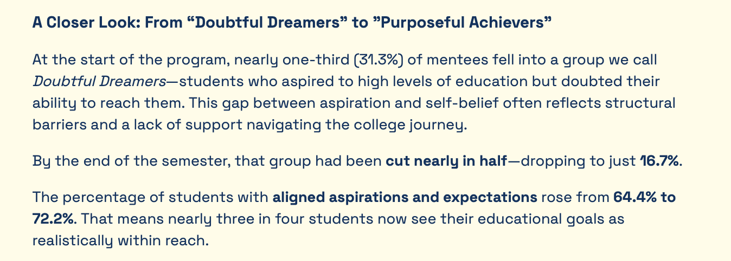

Slide 23
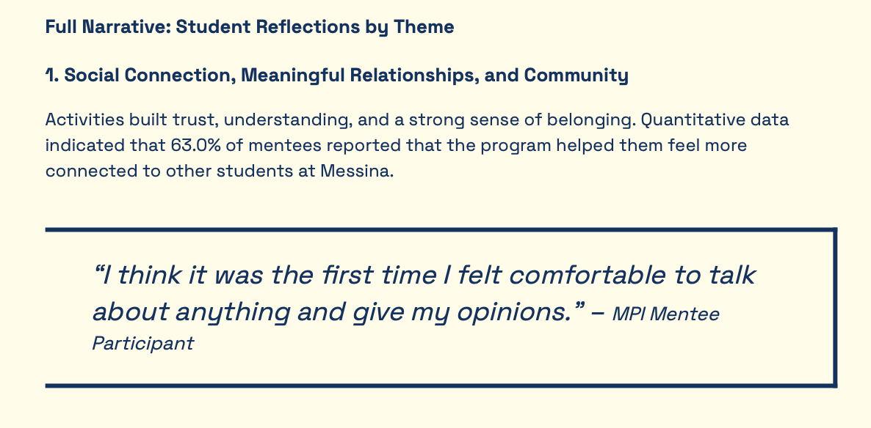

Slide 24

MAKE IT FUN.
26

Slide 25

What do you do for fun?

Slide 26

WHAT IS FUN?
Fun is engaging
...NOT ENTERTAINING
Fun is novel
...NOT SILLY
Fun is shared
...NOT CONSUMED
28

Slide 27

IT ENGAGES OUR MINDS.
“This connects to something important in the world.”
FUN IS ENGAGING.
“Why does this matter?”
ENGAGEMENT IS INTERACTIVE.
IT ENGAGES OUR HEARTS.
“This matters to me as a person.”
“Why do I care?”
29

Slide 28

IT IS UNEXPECTED.
“I’ve never done this before.“
FUN IS NOVEL.
“I’ve never done it this way before.”
NOVELTY IS INTERESTING.
IT IS UNEXPLORED
“I’ve never thought about this before.“
“I’ve never thought about it like this before.“
30

Slide 29


IT IS A SHARED INTERACTION.
“We are thinking together”
FUN IS SHARED.
“We are acting together.”
SHARING IS CARING.
IT IS SHARED EXPERIENCE.
“I am understanding your experience”
“You are understanding my experience”
31

Slide 30

What’s most likely to spark student motivation in your classroom?
A. Relevance to life or identity
B. Autonomy and choice
C. Fun or positive emotion
D. A meaningful challenge
E. Social connection or collaboration

Slide 31

Let’s have some fun.

Slide 32



You Love To See It

Slide 33



ROUND ONE: WHAT DO YOU LOVE TO SEE?
What qualities are you looking for in your students' work that make you proud or excited?
What do students do in their work that shows you that they are learning?
“They explain their thinking in their own words”
“They connect what they’re learning to their own life”
“They share a new or creative idea”
35

Slide 34


ROUND TWO: ACCURATE & CORRECT
What are things that are important to be done correctly and accurately, but not as important to you?
Citation & Reference Formats
Spelling & Grammar
Specific Standards
36

Slide 35



ROUND THREE: MAKERS & MANAGERS
MANAGER MODE:
MAKER MODE:
Accuracy and correctness according to standards is what’s most important.
Students can use AI tools for support.
Students should always do this work themselves.
Their ideas and opinions are what’s most important.

Slide 36
What is the biggest barrier to deeper collaboration in your classroom?
A. Time/test pressure
B. Classroom management issues
C. Lack of student interest
D. Confidence/skill gaps
E. Not sure how to design for it

Slide 37
Which of the following offerings would be most helpful to you in making your classroom more fun and engaging?
(Select all that apply)
A. Ready-to-use lesson plans designed for fun and engagement
B. Activity ideas and templates that spark novelty and excitement in the classroom
C. AI-assisted tools to help educators adapt and enhance their own content to be more fun and engaging, using our framework
D. Classroom tools for learning assessment, goal planning, and collaborative experiences—all designed to make learning more novel and engaging
E. Training, workshops, or a community of practice focused on creating fun, relevant, and collaborative learning experiences

Slide 38
How can we bring fun back to the classroom?

Slide 39
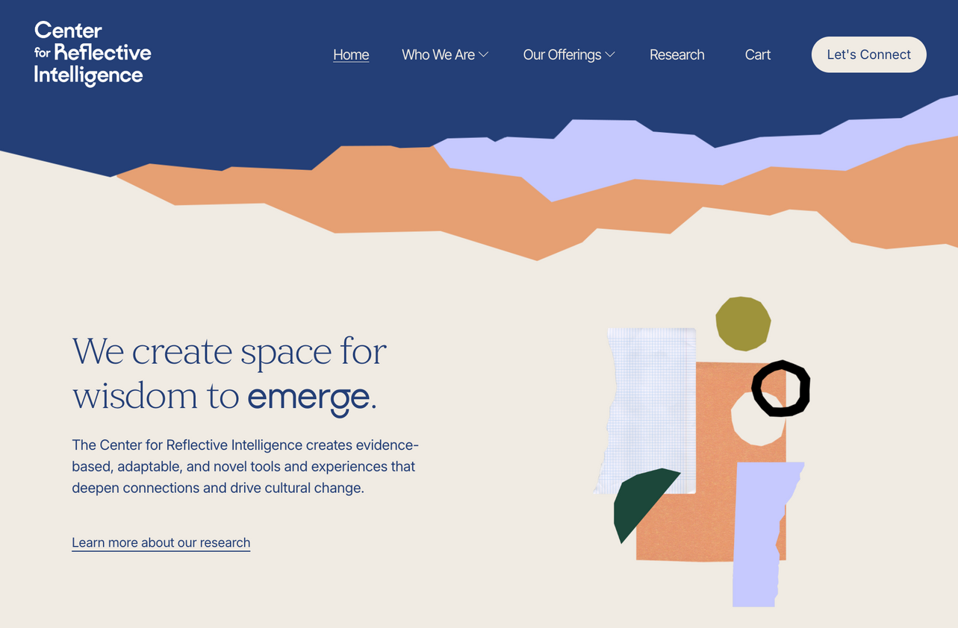

Need tools/workshops for Purpose & Belonging?
Find us at reflectiveintelligence.org.

Slide 40
Dr. Belle Liang
liangbe@bc.edu
Center for Reflective Intelligence
Tim Klein, LCSW
kleinti@bc.edu
Center for Reflective Intelligence
LaShawn Springer, Director of Inclusive Pedagogy
Macmillan Learning
lashawn.springer@macmillan.com
macmillanlearning.com

