Slide 1
Modern approaches to teaching business cycles
Kevin Milligan and Justin Wolfers

Slide 2
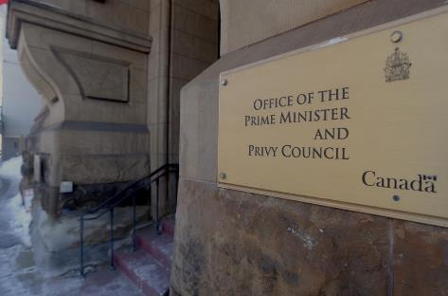
Teaching Canadian macro policy
How do actual policy makers discuss macro?
What do our students read?

Slide 3
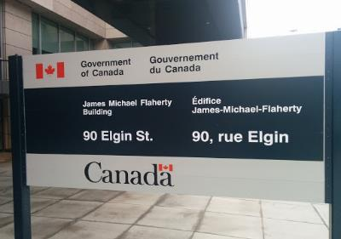
Teaching Canadian macro policy
Monetary Policy
Fiscal Policy

Slide 4
Teaching Canadian macro policy
Monetary Policy

Slide 5
Monetary: The Bank
The Bank is not the Fed
Origin story
Oversight
History
James Coyne

Slide 6
Monetary: The Framework
The 2% target
Why
How
When

Slide 7
Monetary: Don’t fluff the details

Slide 8
Monetary: Don’t fluff the details
How I learned it
Open market operations?
“discount window”?
Money supply shifts?

Slide 9
Monetary: Don’t fluff the details
How I learned it
How it actually works
Open market operations?
“discount window”?
Money supply shifts?
Bank rate / operating band.
Managing overnight market as govt’s banker.
Repos / reverse repos.
Quantitative easing.

Slide 10
Teaching Canadian macro policy
Fiscal Policy

Slide 11
Fiscal: The Canadian Way
Not just monetary policy is different.
Students need to understand our fiscal institutions to get fiscal policy right.

Slide 12
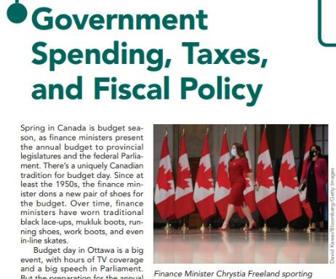
Fiscal: The Canadian Way
New Shoes!

Slide 13
Fiscal: Who does what?
Can’t talk fiscal policy without a rundown of who does what.
Pensions, schools, health, defence.

Slide 14
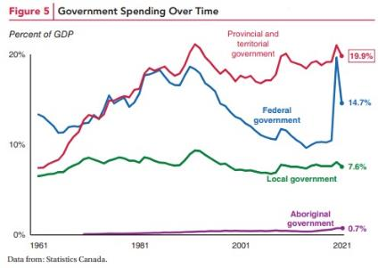
Fiscal: Who does what?
Can’t talk fiscal policy without a rundown of who does what.
Pensions, schools, health, defence.

Slide 15
Fiscal: Who does what?
Not just fed/prov/local….
Opportunity for organic indigenous content.

Slide 16
Fiscal: Is debt a problem?
The story of government debt in Canada follows its own path.
Too big? Not a problem? A balanced discussion.

Slide 17
Fiscal: Is debt a problem?
You have to get the story right.

Slide 18
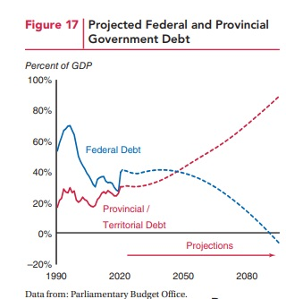
Fiscal: Is debt a problem?
You have to get the story right.
It’s provincial more than federal debt that might cause problems.

Slide 19
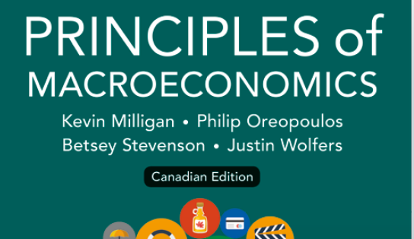
To learn more…

Slide 20
Modern approaches to teaching business cycles
Kevin Milligan and Justin Wolfers

