Slide 1
REAL NEWS vs. FAKE NEWS
Bettina Fabos
Co-author, Media & Culture

Slide 2
TEACHING: How to verify the truth and keep people and their ideas accountable?

Slide 3
TEACHING: How to verify the truth and keep people and their ideas accountable?
Academic discipline of verification

Slide 4
TEACHING: How to verify the truth and keep people and their ideas accountable?
Academic discipline of verification
Scientific discipline of verification

Slide 5
TEACHING: How to verify the truth and keep people and their ideas accountable?
Academic discipline of verification
Scientific discipline of verification
Journalistic discipline of verification

Slide 6
JOURNALISM: A Discipline of Verification
Kovach and Rosenstiel’s The Elements of Journalism
There are 10 elements of journalism, but we’ll focus on first 3:
Journalism’s first obligation is to the truth.
Its first loyalty is to citizens.
Its essence is a discipline of verification.

Slide 7
How do we know when we are encountering professional journalism?
Criteria for determining fake news
15-point checklist for students to work through the criteria

Slide 8
Fake news is two things
An accusation – “that’s fake news!”
Deliberate misinformation
We like this definition from Alex Gelfert:
Fake news is the deliberate presentation of (typically) false or misleading claims as news, where the claims are misleading by design.
-Alex Gelfert, “Fake News: A Definition,” Informal Logic 38 (1), 2018, 84-117.

Slide 9
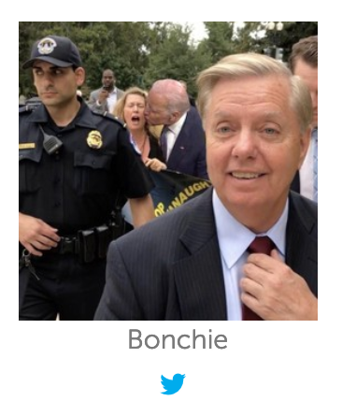
A. FAKE PRESENTATION: Credibility of the Organization
Does the story provide bylines for reporters and bios for those reporters? ➡️
Does the site include the news organization’s address, telephone number, and email address?
Does the site provide a link or email address to report corrections or errors?
Writer for RedState.com (it’s not Lindsey Graham) Identity unclear.

Slide 10
B. FALSE OR MISLEADING CLAIMS:
Validity of Claims
Does the story provide verification through original reporting that cites multiple sources? ⬇️
Does the story fact-check sources? (Be wary of stories that accept potentially untruthful or incorrect quotes or allegations from sources at face value, and fail to question them.) ⬇️
Breitbart, Sept. 29, 2020

Slide 11
B. FALSE OR MISLEADING CLAIMS:
Validity of Claims
Does the story cite original sources? (Be wary of stories that rely heavily on secondary sources including social media posts and other published media reports as their main form of reporting.) ⬇️
Does the story cite external sources beyond its own news organization? (Be wary of stories that rely on other stories from the same outlet.)
Story in The Daily Caller, Sept. 16, 2020 – no original reporting; citing suspicious external sources

Slide 12
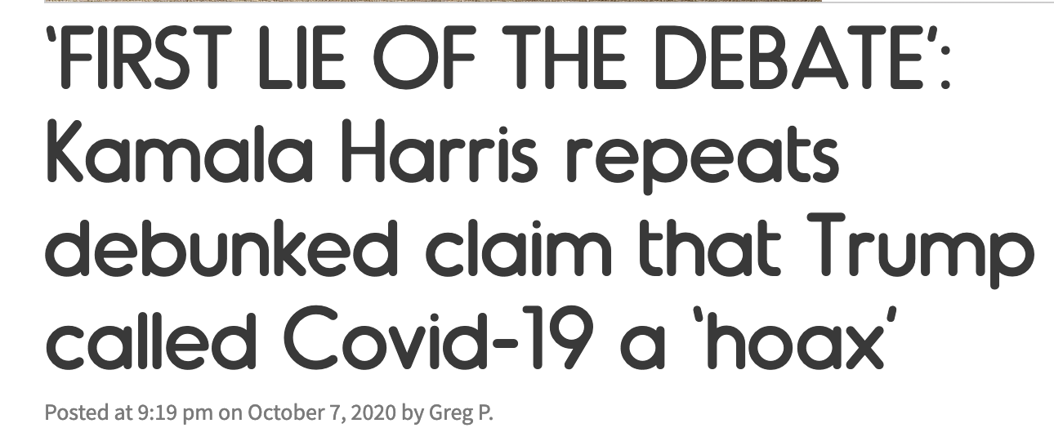
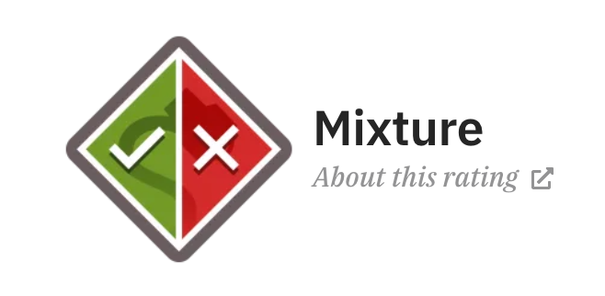
B. FALSE OR MISLEADING CLAIMS:
Validity of Claims
8. Does the story accurately represent what the story’s sources (either cited or linked) actually said? ⬇️
9. Does the story “check out”? That is, do other reliable news organizations verify this?
Twitchy.com , Oct. 7, 2020, says Trump never called COVID-19 a hoax. Snopes.com, Mar. 2, 2020, says Trump’s comment is a mixed verdict.

Slide 13
C. MISLEADING BY DESIGN: Ethics of Purpose
Does the site disclose the company’s ownership and funding sources?
Does the news organization provide an accessible code of ethics or standards and procedures document? ⬇️
Townhall.com discloses ownership, but doesn’t have a code of ethics.

Slide 14
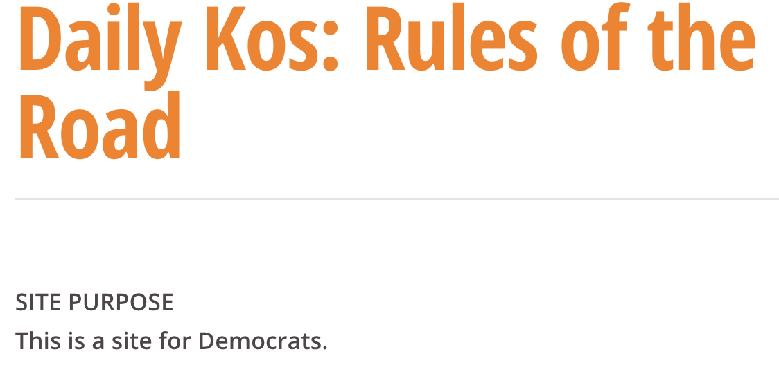
C. MISLEADING BY DESIGN: Ethics of Purpose
12. Does the story:
embrace a range of valid opinions rather than just one position, ➡️
or
b. avoid false balance or “bothsidesism” between two viewpoints when the great majority of evidence suggest only one side is true?
Daily Kos disclosure

Slide 15
C. MISLEADING BY DESIGN: Ethics of Purpose
13. Does the headline accurately represent what the actual story says, rather than exaggerate?
14. Does the story avoid personal attacks on people or sources? ➡️
15. Does the story avoid stereotypes to makes its point?
RedState, Oct. 6, 2020

Slide 16
Lists of reliable news sources = political.
Pew, 2014.
Poynter, 2019 (withdrew after backlash).
With our 15-point list, you can talk about fake news/deliberate misinformation without getting bogged down in knee-jerk political reactions. Students will work through it themselves.

Slide 17
Lists of reliable fact checking sources
FAKEY app
Snopes.com
Politifact.com
Fact Checker (Washington Post)

