Slide 1

Teaching the Solow Model in Principles of Economics: From Catching-Up to Cutting Edge Growth
Alex Tabarrok

Slide 2
A Puzzle: Why Did China Grow Quickly?
In 2010, GDP per capita in China grew by nearly 10% but by just 2.2% in the United Sates.
How can this make sense? Is there something wrong with the U.S. economy? Do the Chinese have a magical potion for economic growth?
Remember (Ch. 7), among the key institutions promoting economic growth are property rights, honest government, political stability, a dependable legal system, and competitive and open markets.
But for each and every one of these institutions, the United States ranks higher than China.
So why has China grown so much more rapidly than the United States?
Notes:
In its entire history, the U.S. economy has never grown as fast as the Chinese economy grew in 2010.

Slide 3

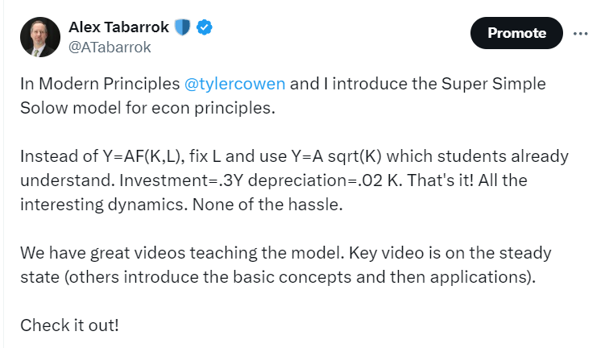
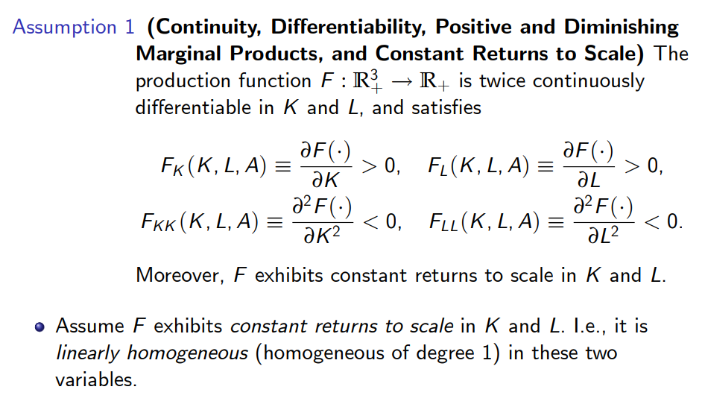
The Solow Model
The Super Simple Solow Model

Slide 4
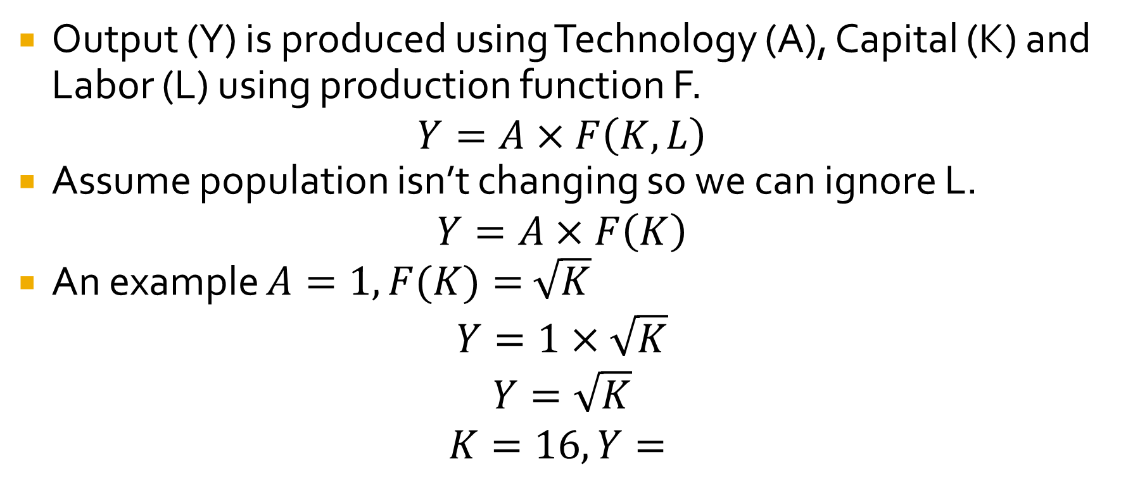
The Super Simple Solow Model
Output (Y) is produced using Technology (A), Capital (K) and Labor (L) using production function F.
$$Y=A×F\left(K,L\right)$$
Assume population isn’t changing so we can ignore L.
$$Y=A×F\left(K\right)$$
An example $A=1, F(K)=$ $\sqrt{K}$
$$Y=1×\sqrt{K}$$
$$Y=\sqrt{K}$$
$$K=16, Y=$$
4
?
Notes:
Get concrete as quickly as possible.

Slide 5
Properties of the Production Function
Output, Y
Output increases with more K.
Output increases at a diminishing rate--Diminishing Marginal Returns.
…increases output just a little.
3
2
1
…increases output a lot.
The first unit of K…
The 10th unit of K…
Capital, K
0 1 2 3 4 5 6 7 8 9 10 11 12 13

Slide 6
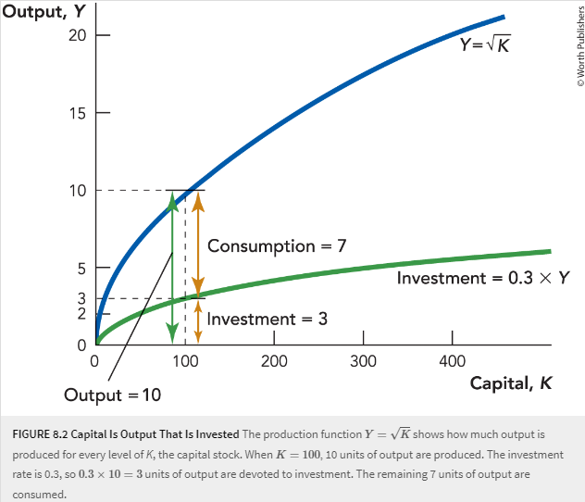
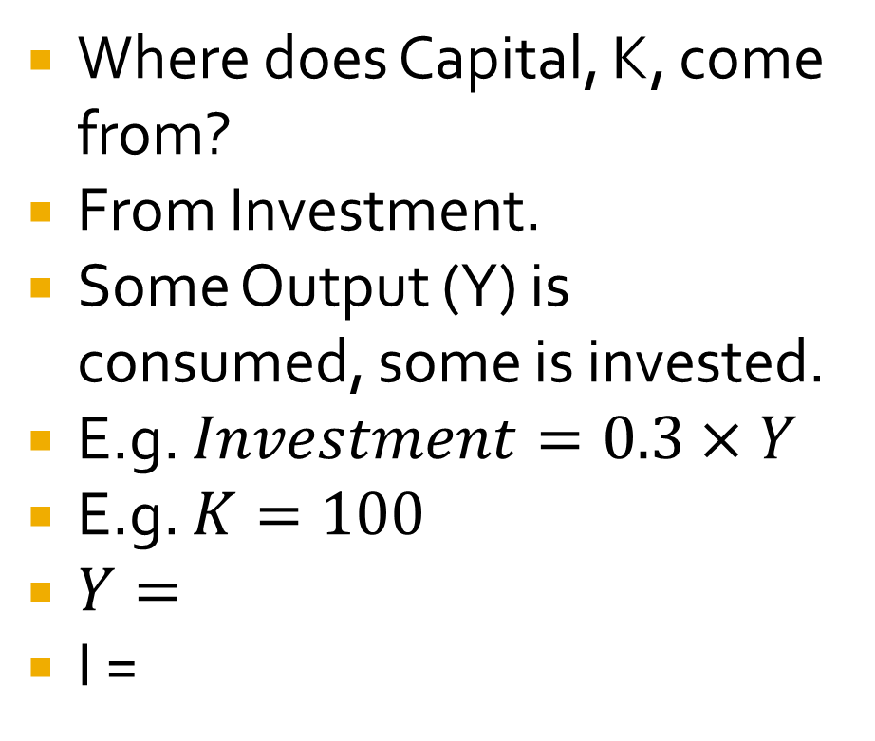
Investment
Where does Capital, K, come from?
From Investment.
Some Output (Y) is consumed, some is invested.
E.g. $Investment=0.3×Y$
E.g. $K=100$
$Y=$
I =
10
?
3
?

Slide 7
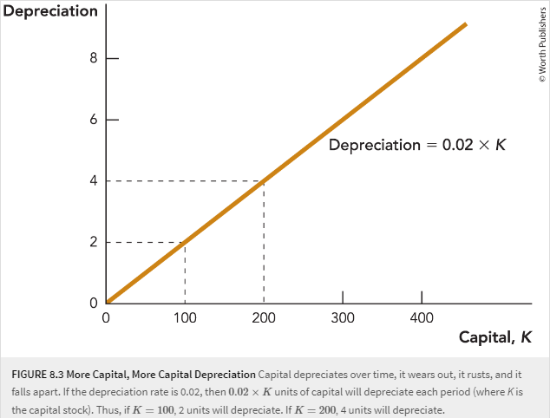
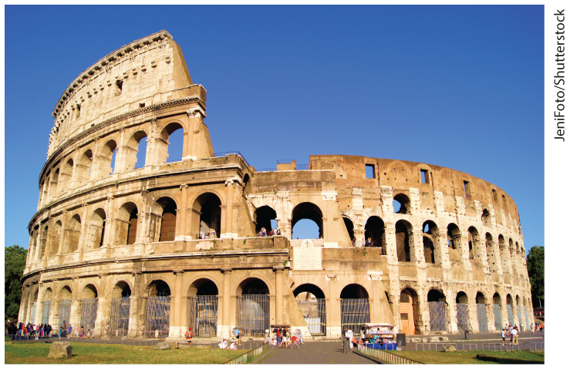
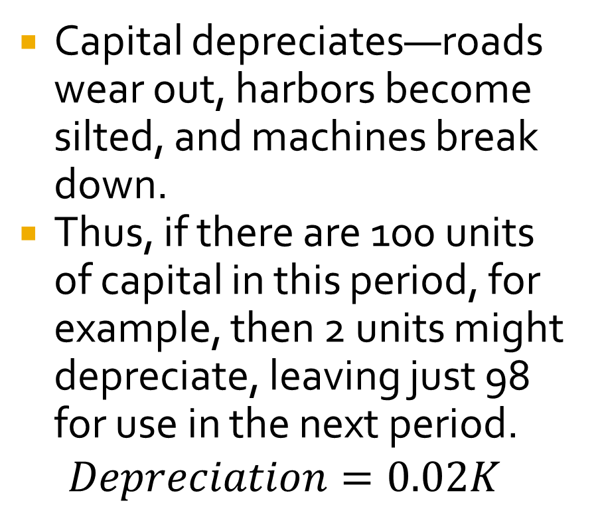
Capital Depreciates
Capital depreciates—roads wear out, harbors become silted, and machines break down.
Thus, if there are 100 units of capital in this period, for example, then 2 units might depreciate, leaving just 98 for use in the next period.
$$Depreciation=0.02K$$
Rome did not replenish it’s capital stock.

Slide 8
Capital Accumulation
Y
Investment adds to the capital stock.
Depreciation subtracts from the capital stock.
  If I > D, then K will grow.
  If I < D, then K will decline.
  If I = D, then K will remain constant—the steady state.
Depreciation = 0.02K
8
6
4.5
3
0
When Inv < Dep…
…the capital stock declines.
Investment = 0.3Y
The result is a steady state where Inv = Dep.
When Inv > Dep…
…the capital stock grows.
0 100 200 225 300 400
Capital, K
8

Slide 9

Capital Accumulation Causes “Catching-Up” Growth
Growth slows as steady state is approached.
Output, Y
Growth ends in steady state.
Steady state Output
Y=Output
When capital is in the steady state, output is in the steady state
Depreciation
$$\text{Investment}$$
First units of capital are very productive.
Growth is fast
Steady state capital
Capital, K
Starting at K < steady state K causes capital accumulation…

Slide 10
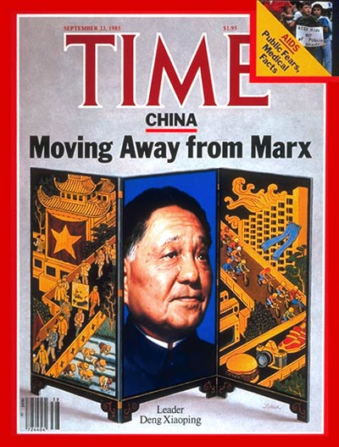
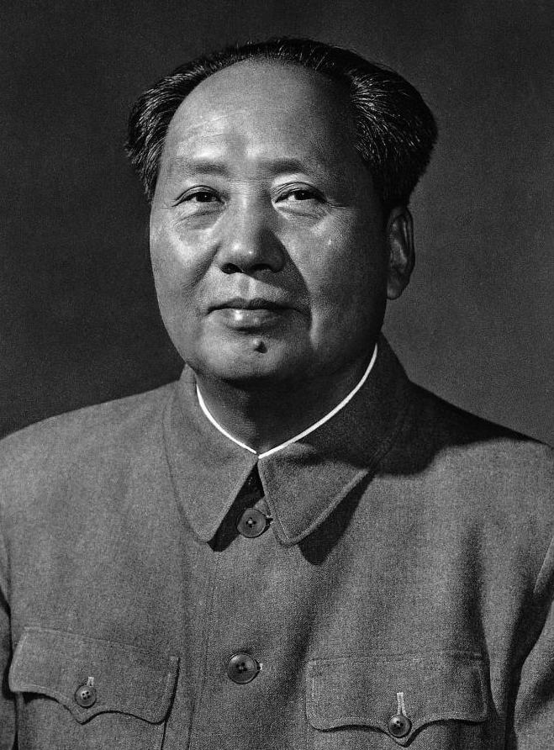
Answering the Puzzle
In 1970, China had a GDP per capita of $113 (WB, $2024).
  Almost no capital->almost no output.
  Steady state under communism.
Mao dies 1976, replaced by Deng Xiaoping in 1978.
“Socialism and market economy are not incompatible”
Investment increases as a fraction of output. New steady state. Growth starts fast and then slows down.

Slide 11
Answering the Puzzle.
Why did China grow quickly? It was catching up.
Catching Up Growth: increases in output that occur as a result of capital accumulation as the economy moves toward its steady state (a.k.a. “transitional” growth).
Key Characteristics:
  Must eventually fizzle out (because of Diminishing Marginal Returns)
  Cannot explain growth in the very long run
  Implies convergence (again, because of Diminishing Marginal Returns)
  Explains China’s shift from high growth, high capital accumulation to lower growth and greater depreciation as it approaches steady state.

Slide 12
“Cutting-Edge” Growth
The US economy is still growing. How come?
Cutting edge growth.
New Ideas:
  “A” returns to the production function:
  Increases in A represent new ideas (a.k.a. technology)
  New ideas shift the entire production function
  New ideas increase the productivity of all factors of production
  No increase in K required to achieve growth

Slide 13
New Ideas Shift the Production Function Up
Output, Y
New ideas mean that we get more output from the same amount of capital.
15
10
0 100
Capital, K

Slide 14
Cutting-Edge Growth (Cont’d)
Cutting-Edge Growth: increases in output resulting from the continuous flow of new ideas.
Key Characteristics:
  Can explain growth in the very long-run
  Does not require capital accumulation
  Fundamentally different from catching-up growth—results from a different source
  Generates more catching-up growth, too

Slide 15
Putting it All Together
Output, Y
c
33.7
Output grows more
b
22.5
Output grows
Better
Ideas
15
a
Dep = 0.02K
Inv = 0.3*1.5Y
Inv = 0.3Y
Capital Accumulation
225
506
Capital, K
Initial steady state
New steady state

Slide 16
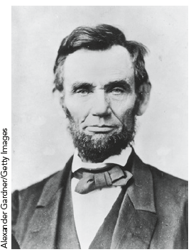
The Economics of Ideas!
Where do Ideas come from? How do we get more?
Spillovers, property rights, the benefits and costs of patents
Ideas and Market Size (free trade and ideas)
The Future of Economic Growth
“The patent system…added the fuel of interest to the fire of genius.”
Abraham Lincoln

Slide 17
Summary: The Solow Model and Why it is Fun to Teach
Connects micro to macro concepts (production function, marginal product, diminishing marginal returns, spillovers, property rights, innovation)
Highlights the role of investment and capital accumulation in the growth process
Distinguishes between “catching-up” and “cutting-edge” growth.
  Explains how some countries with poor institutions can grow faster than countries with good institutions. Leads to discussions of growth versus steady state (level).
Leads directly to thinking about the economics of ideas

Slide 18
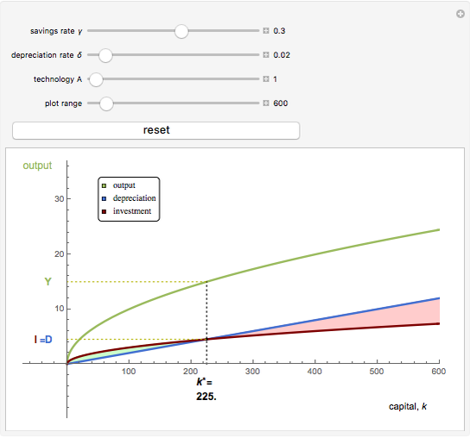
Resources!
Video! – MRU and Achieve
Lesson Plans - MRU
Wolfram App -- Wolfram

